Slide 1
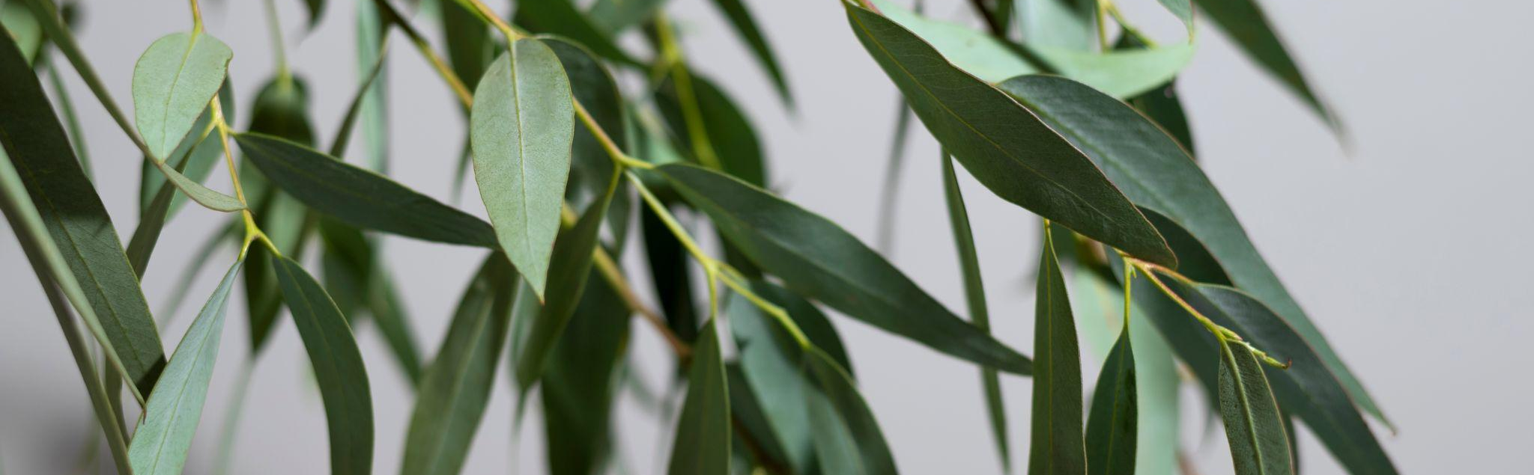
Plant medicinal leaf detection using deep learning
This project is centered around the development of a deep learning model for the identification of medicinal plant leaves.

Slide 2
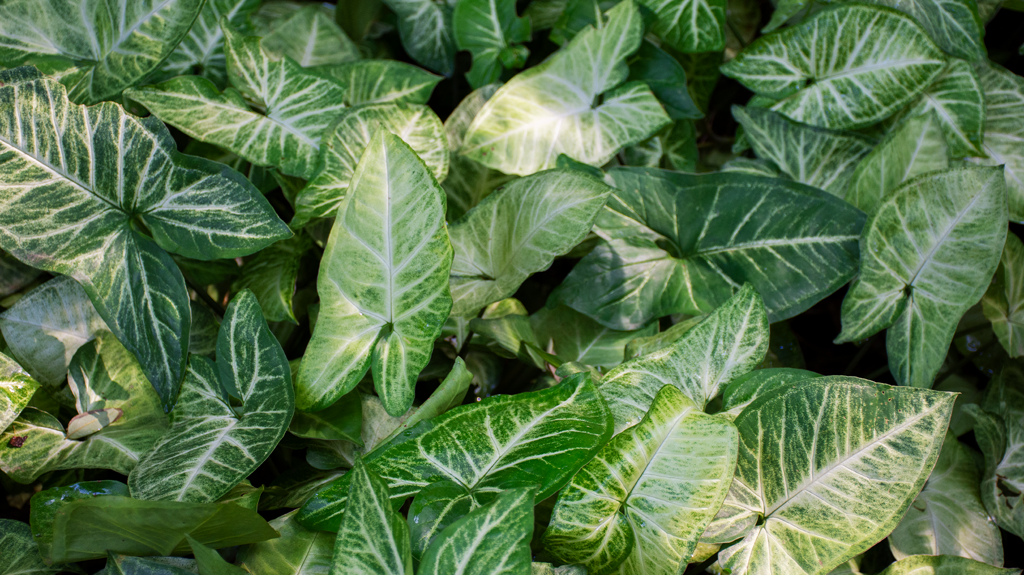
In our project, we harness advanced image processing with a pre-trained ResNet50-V2 model to accurately identify medicinal plants, focusing on endangered species. Utilizing the mendeley dataset, we apply data augmentations like flips and rotations for enhanced model robustness. Our optimized model, trained over 10 epochs with a Reduce LR on Plateau callback, efficiently bridges traditional herbal medicine with modern technology, contributing to the vital conservation of plant biodiversity.

Slide 3
Table of contents
01
02
03
04
05
06
Introduction
Research Aims & Objectives
Methodology
Model architecture
Model results
Conclusion & future work

Slide 4

About traditional herbalism
Traditional herbalism, rooted in ancient wisdom, harnesses the therapeutic properties of plants, offering a time-honored approach to healing and wellness. This practice, deeply intertwined with cultural heritage, relies on the intricate knowledge of medicinal plant properties and their applications in natural remedies.

Slide 5

Introduction
Our project revolutionizes the identification of medicinal plants using cutting-edge deep learning, blending technology with herbal tradition to safeguard plant biodiversity. Employing a sophisticated ResNet50-V2 model, we offer a novel, efficient solution for classifying diverse plant species, particularly those at risk of extinction.

Slide 6
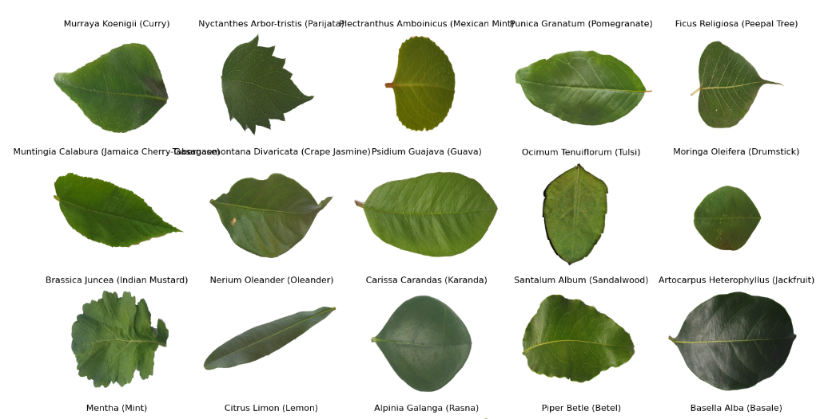
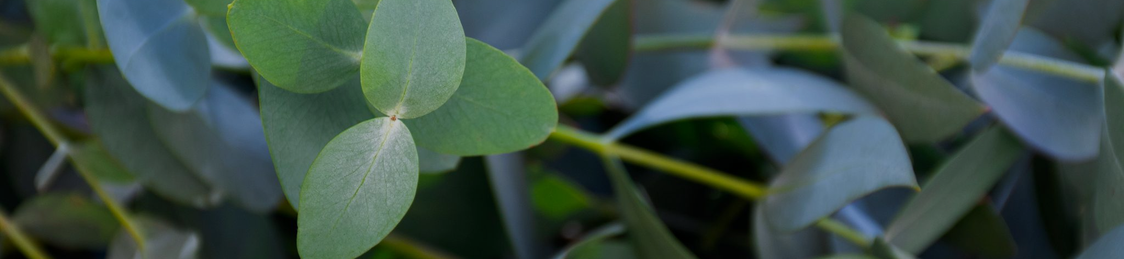
Research Aims & Objectives
To Develop an Automated Plant Identification System:
o Integrate Traditional Herbal Knowledge with Modern Technology.
To Contribute to the Conservation of Medicinal Plant Biodiversity:

Slide 7
Methodology
Data collection
Augmentation
Results
This enables the model to generalize better to new, unseen data and reducing the likelihood of overfitting.
High accuracy attained in classifying diverse medicinal plant species.
Mendeley dataset
01
02
03
04
05
Architecture
Training
ResNet50v2 as backbone with exclusion of top layers and custom softmax layer
Model trained over 20 epochs, achieving optimal performance and accuracy.

Slide 8
Model Architecture
ResNet50V2 Backbone: The ResNet50V2 architecture, known for its deep residual learning framework, addresses the vanishing gradient problem, allowing the training of much deeper networks. Its capabilities in feature extraction make it an excellent choice for our high-resolution leaf images.
Exclusion of Top Layers: The top layers of the ResNet50V2 are excluded to tailor the model to our specific task. This is a standard practice in transfer learning, where the general feature detection capabilities of the base model are combined with custom layers that focus on the specific classification task.
Custom Softmax Layer: A fully connected layer with a softmax activation function is added to classify the 22 different leaf types. The softmax layer provides a probability distribution over the 22 classes, making it suitable for multi-class classification.

Slide 9
Data augmentation
Rotation: Images were rotated by up to 40 degrees, allowing the model to learn from different orientations.
Dimensional Shifts: To introduce a sense of spatial variability, both width and height shift ranges are set to 0.2.
Shear Transformation: A shear range of 0.2 applies a counter-clockwise shearing transformation.
Zoom: A zoom range of 0.2 offers the model exposure to different scales.
Horizontal Flipping: This augmentation enhances the model's ability to recognize symmetrical properties in leaves.

Slide 10

Model training
The training of our deep learning model was meticulously executed over 10 epochs, utilizing a data generator approach for efficient image handling and on-the-fly augmentation. Employing the Adam optimizer and categorical cross-entropy loss function, the model underwent a rigorous learning process, fine-tuned through the strategic use of a Reduce LR on Plateau callback. This methodical training, complemented by real-time monitoring via TensorBoard, ensured optimal model performance with enhanced accuracy in medicinal plant leaf classification.

Slide 11
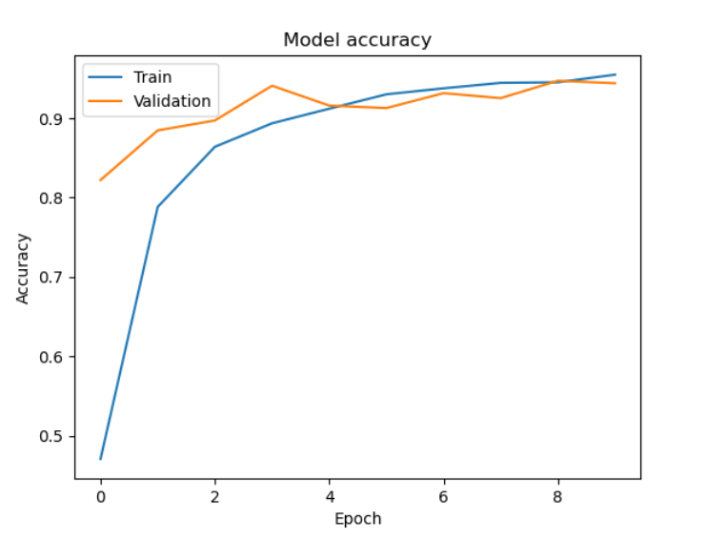
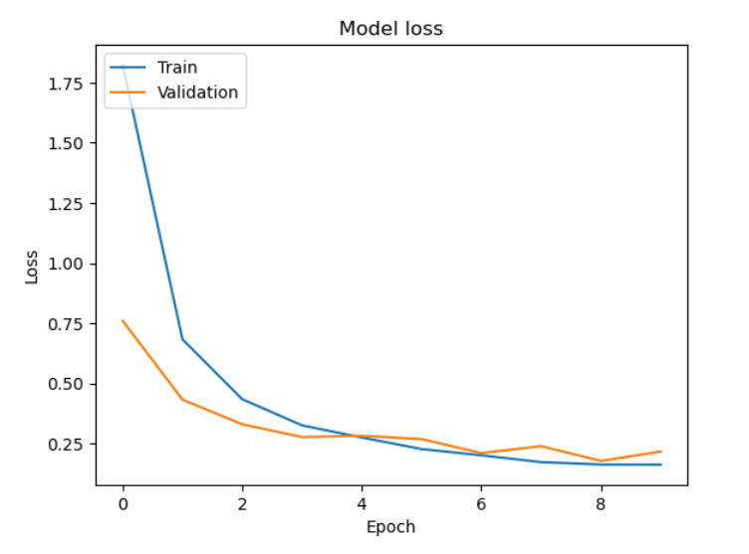
Model Results

Slide 12
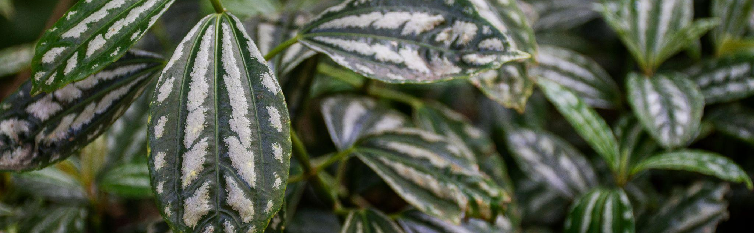
Conclusions
In this project, we've successfully built and trained a deep learning model to identify plant species from images. We've covered data preprocessing, model architecture, training, evaluation, and inference steps. The final model can be used to classify plant species from new images effectively.

Slide 13

Future recommendation
Ensemble Learning: Investigate advanced ensemble learning techniques, such as Gradient Boosting and Stacking, to further enhance model performance and diversity.
Transfer Learning: Explore transfer learning approaches using pre-trained neural network models (e.g., TensorFlow Hub, PyTorch Hub) to leverage knowledge from larger datasets and adapt it to our plant species classification task.
Deployment and Integration: Extend the project by deploying machine learning models into real-world applications, such as mobile apps or web platforms, to make automated plant species identification accessible to a broader audience.

